Slide 1

Slide 1
Visualizing the Google Trends Dataset to understand consumer patterns
Technologies: Google BigQuery, Advance SQL Queries, Tableau

Slide 2



Slide 1
Challenge: Create interactive dashboards that allow business users to analyze trends, compare the popularity of googled terms, and forecast future trends to inform strategic business decisions.

Slide 3



Slide 1
About the Data- 800 million + rows
An excerpt of the dataset is given below. The entire dataset can be found here.
The dataset from Google Cloud Marketplace includes the Top 25 most searched and Top 25 rising search queries daily across the U.S., segmented by market areas and enriched with a five-year historical backfill, with data expiring after 30 days
Extracted US data from “Country_Code” & Regional data (state) from “Region_Code
Since multiple terms were having top 3 ranks, we have used “Score” to break ties
Calculated % changes with the help of “Score” and rankings with the help of “Rank” columns

Slide 4

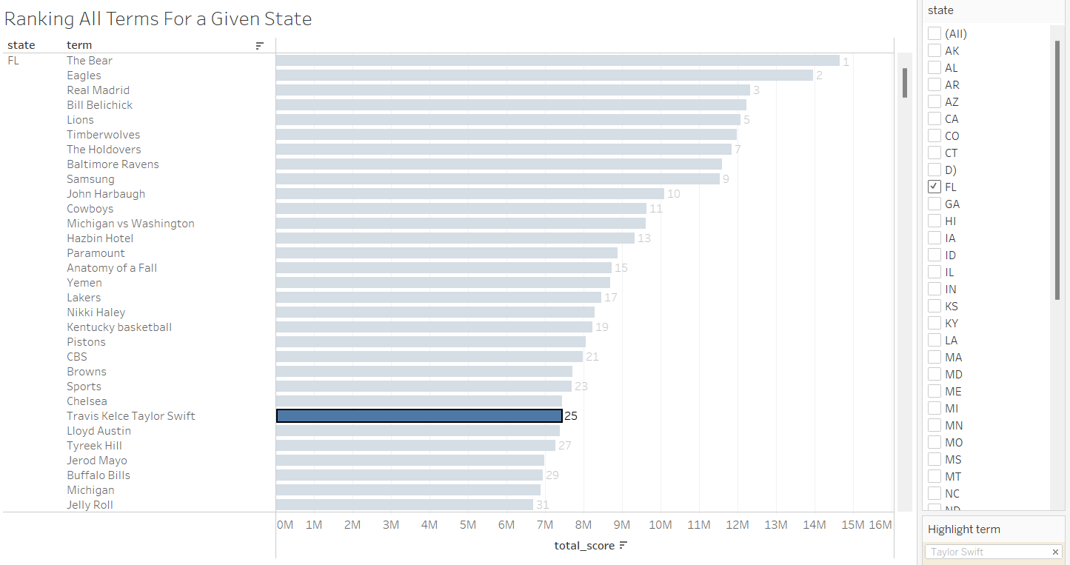
Summary ranking data per US state
Dashboard that shows ALL the terms trending for a particular state from highest ranked, to lowest ranked
The dashboard displays trending terms for each US state, ranked from highest to lowest, allowing for a comprehensive view of monthly search trends specific to regions like Florida
Users can apply filters to examine search trends for any state in the US, facilitating targeted regional analysis
Scenario: Hired by Taylor Swift to gauge trends in Florida for upcoming Eras Tour
Analysis and Interpretation:
Current trending terms helps understand Taylor Swift’s standing with the public of different states
Swift is interested in a concert in Florida, which will work in her favor as she is currently ranked 25th in the state.
State
2

Slide 5
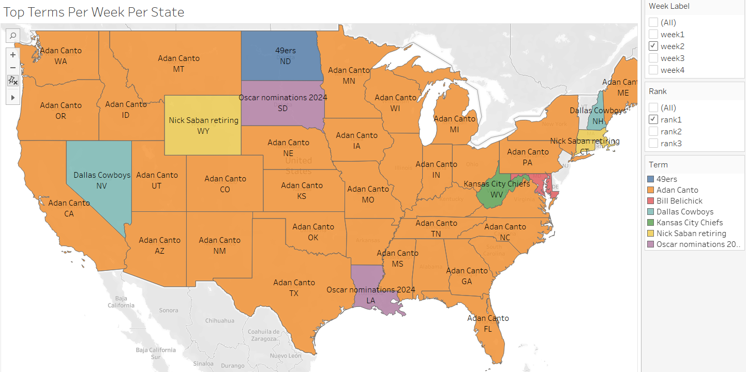
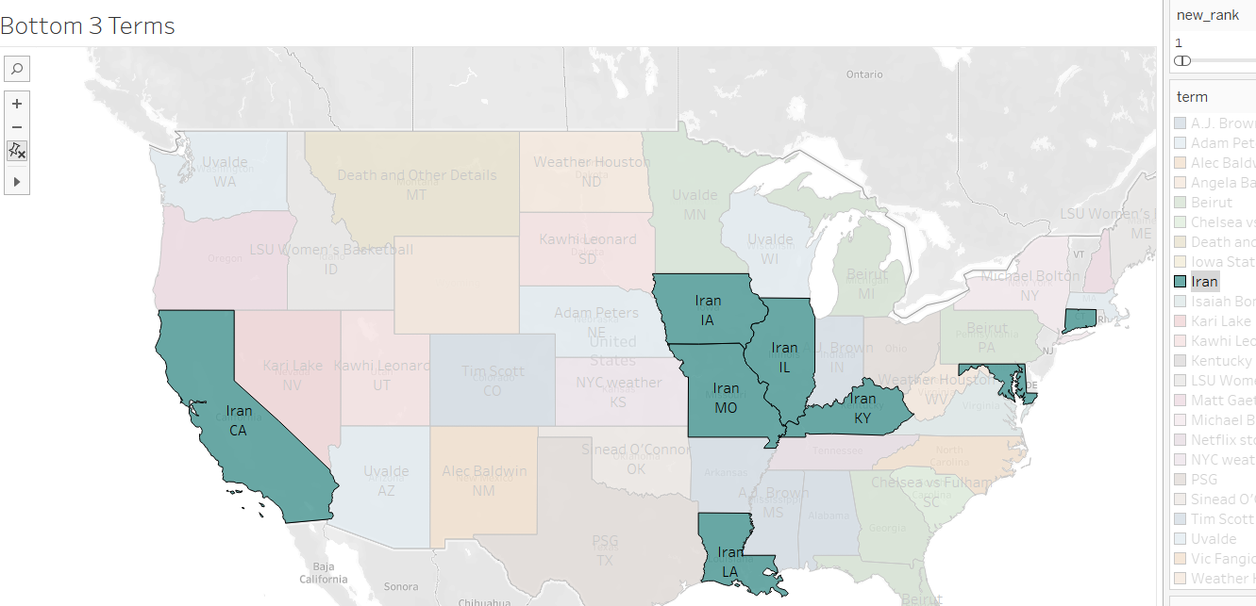
Using the "rank" filter, users can easily view terms of a specific rank across different states on the map for a given “week”
Insights from Top Terms:
Utilizing top terms allows PR firms to proactively assess their clients' regional popularity, facilitating data-driven PR decision-making tailored to specific geographic markets
Can also filter based on weeks to study weekly and monthly data
Top 3 terms per state (Filter using Rank and Term)
Shows “Iran” as the least trending term for highlighted states
Week
Rank
Insights from Bottom Terms:
Business sectors can leverage this data to gauge whether their marketing concepts align with emerging trends that may be approaching the brink of unpopularity. Armed with such insights, they can then fine-tune and adapt their marketing strategies accordingly.

Slide 6

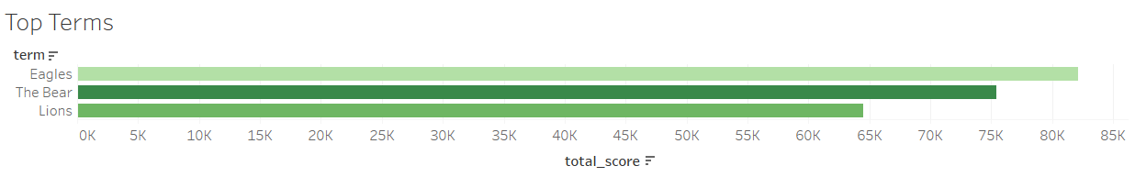



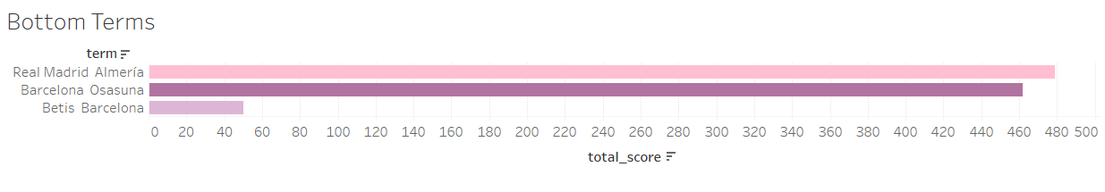
Top and Bottom 3 terms in the whole of United States (Country Analysis)
National Trending Terms: Top & Bottom Rankings Analysis
Top Terms
This dashboard provides insights into the prevailing countrywide trending terms, making it a valuable resource for businesses gearing up for major marketing campaigns.
By leveraging this data, companies can ensure their campaigns resonate with the broader national audience and maximize their reach and impact.
Monitor your competitors' use of trending terms to benchmark your strategies against industry standards.
Eagles
The bear
Lions
Terms
Total score
Bottom Terms
Real Madrid Almeria
Barcelona Osasuna
Betis Barcelona
Terms
Total score
Notes:
Superbowl – advertisement – 7m –Jason kelchy

Slide 7
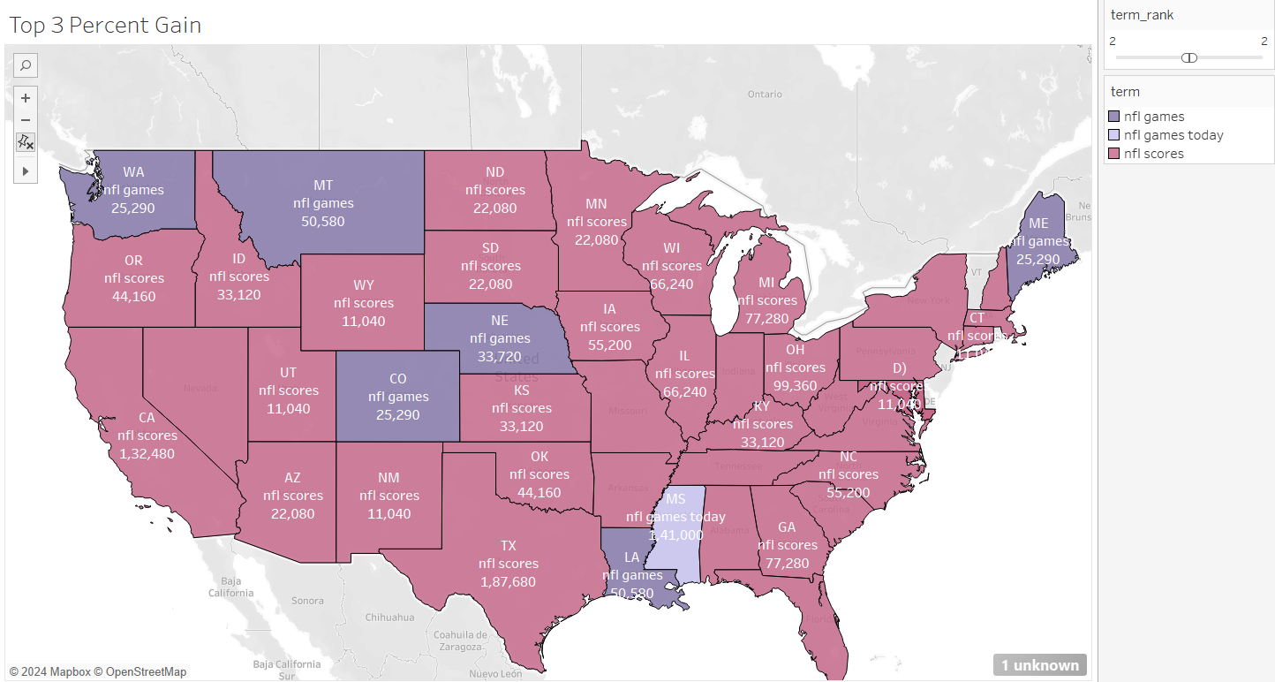
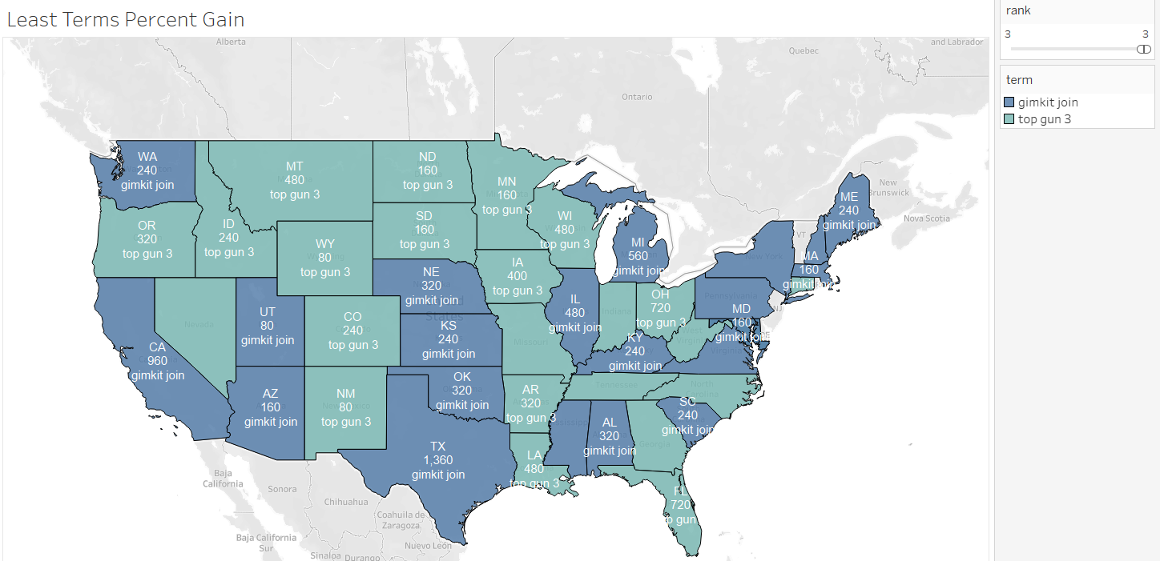
Tracking the Top and Bottom 3 trending terms across US States based on growth in popularity scores
This dashboard provides insights into trending terms across different US states by tracking how certain terms have gained popularity over time. It highlights the top 3 and bottom 3 terms in terms of percentage gain. These insights are crucial not only for understanding current trends but also for forecasting future opportunities
  Consider launching products in states where related terms are showing strong growth—these areas may present emerging opportunities
  Align content creation with the terms that are gaining traction, ensuring engagement with audiences in regions where interest is increasing
Top 3 terms percent gain (Filter using Rank and Term)
Bottom 3 terms percent gain (Filter using Rank and Term)
Rank
Notes:
retrospection

Slide 8
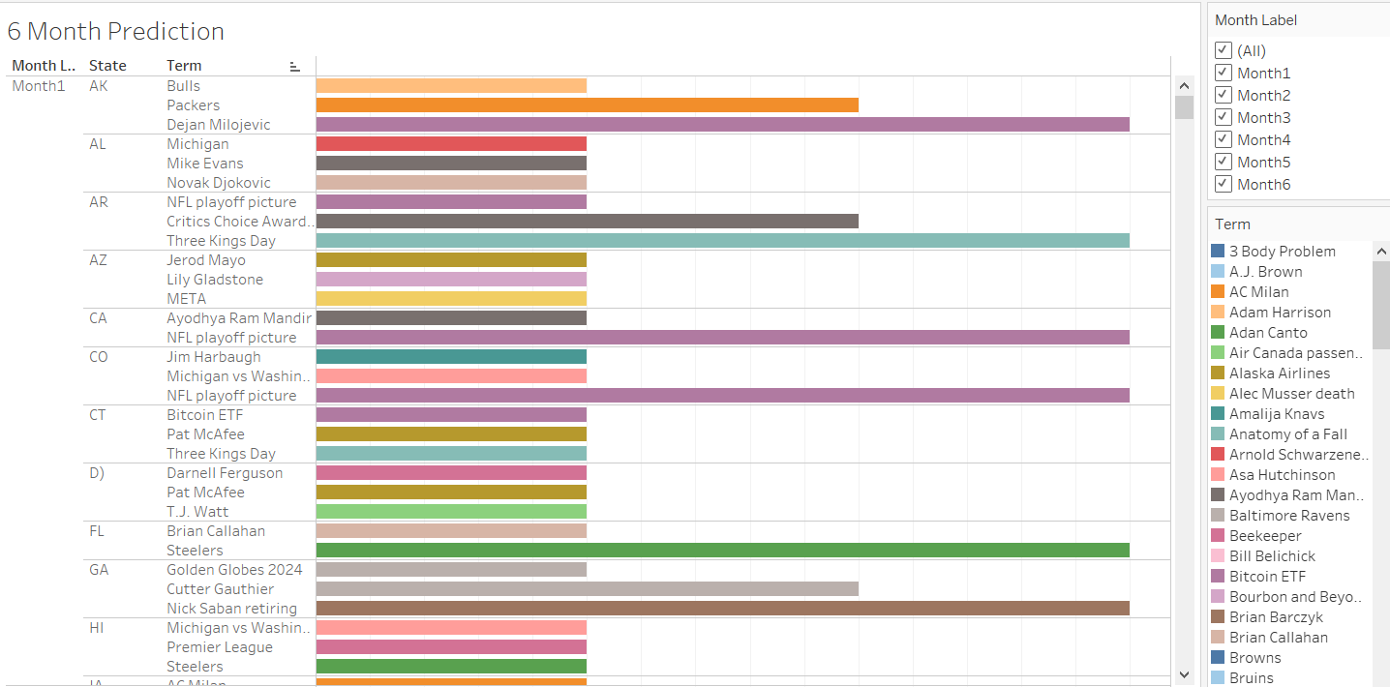
Leveraging Machine Learning to Forecast next six-Month Trending Topics using Arima time series model
The graph shows the trending terms per month for the next 6 months, filtered by month
Event organizers can plan and promote events based on predicted popular themes or topics. This dashboard helps companies allocate their advertising budgets more efficiently by focusing on terms that are predicted to gain traction
Arima time series model: Uses present score to predict future score
Month
32.38
MAE value
35
RMSE value
$186.54
Social Media: Use future terms as hashtags in posts, make reels and shorts on that topic
1
2
Search Engine Optimization: Curation of web content based on terms
Event Planning: Align the theme of future events with trending terms, use social media for promotion
3

Slide 9
Harnessing Data-Driven Insights for Precision Marketing and Strategic Business Growth
These analytical dashboards serve as a pivotal tool for organizations seeking to capitalize on market trends within their strategic marketing initiatives. They empower analysts and marketers to quantify the influence of events on prevailing trends and gauge consumer sentiment regarding specific terms, thereby facilitating informed decision-making.
The granular state-specific insights empower businesses to craft targeted campaigns that resonate with local audiences, optimizing resource allocation and enhancing market penetration.
These dashboards offer analysts insightful foresight into the prospective traction of various terms, enabling enterprises to adeptly tailor their marketing campaigns. The intelligence provided is instrumental in guiding strategic decisions related to potential partnerships, collaborative ventures, and product innovation.
NOTE: Since multiple terms were having top 3 ranks, we have taken the highest score from those and chosen those terms

