Slide 1
UTILIZING MICROSOFT’S GraphRAG RAG TO RETRIEVE DOCUMENTS
Document retrieval has always been an issue in large companies. By applying AI, I’ve worked toward solving this problem. Let’s explore how we can push this solution further.

Slide 2

Agenda
1
Introduction
2
Technical Components
3
Vendor Analysis
4
Change Management
5
Timeline
6
Financials
7
Risk Mitigation
8
Conclusion

Slide 3



Companies want to enhance document management and automate sales and platform analysis
Large companies (>500 employees) are exploring new ways to enhance document management, requirements gathering, platform analysis, and sales automations
The goal is to utilize RAG architecture to build an LLM that leverages previous work outputs to achieve this
What strategic steps should the companies take to acquire talent, optimize processes, and implement technology to successfully develop and operate this LLM?
Introduction
Technical Components
Conclusion
Vendor Analysis
Change Management
Financials
Timeline
Risk Mitigation
3

Slide 4

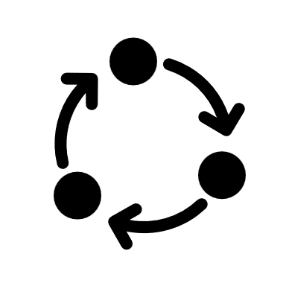
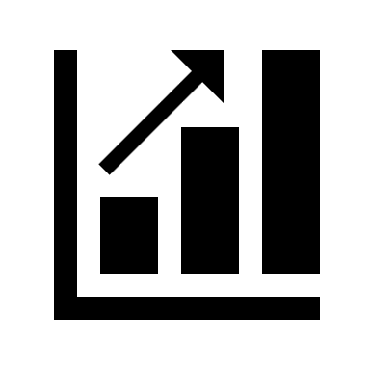

Driving effective execution of the LLM model through People, Process and Technology
PEOPLE
PROCESS
Change Management
Organizational design
Communication
Training & Support
Gap Analysis
Solution Design
Current state v/s future state envision
TECHNOLOGY
Technology understanding
Technology execution: Development + Testing + Support
Architecture building
LLM Model execution
Introduction
Technical Components
Conclusion
Vendor Analysis
Change Management
Financials
Timeline
Risk Mitigation
4

Slide 5

Leveraging advanced AI technologies to create intelligent, context aware, and scalable systems
AI-Powered Systems:
By utilizing LLMs' advanced natural language understanding capabilities and the structured, interconnected insights provided by Knowledge Graphs, companies aim to create a system that delivers precise, contextually rich, and actionable answers
LLM
RAG
Knowledge Graph
Advanced Machine Learning models to generate human like responses
LLMs use Transformer architecture, which employs special techniques like attention and self-attention
Trained on large datasets that include text from books, articles, websites, etc.
Capabilities: Translation, summarization, analysis etc.
Information from large data sources is segmented into chunks and made into vectors
The user's query which is also converted into a vector is compared with database vectors, and the closest match are used to create a refined prompt before the prompt
The system then produces relevant answers
KG organize and represent knowledge in a way that captures relationships between entities (nodes) and the connections (edges) between them
Examples: Search engines, Recommendation systems, Voice assistants etc.
Automated user story generation & document retrieval
Introduction
Technical Components
Conclusion
Vendor Analysis
Change Management
Financials
Timeline
Risk Mitigation
5

Slide 6
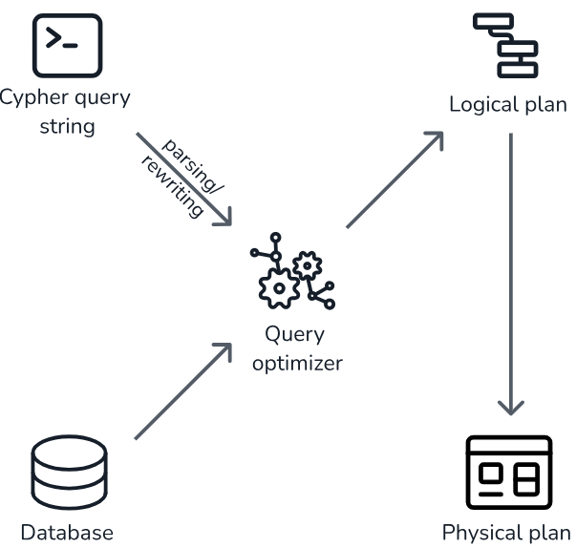
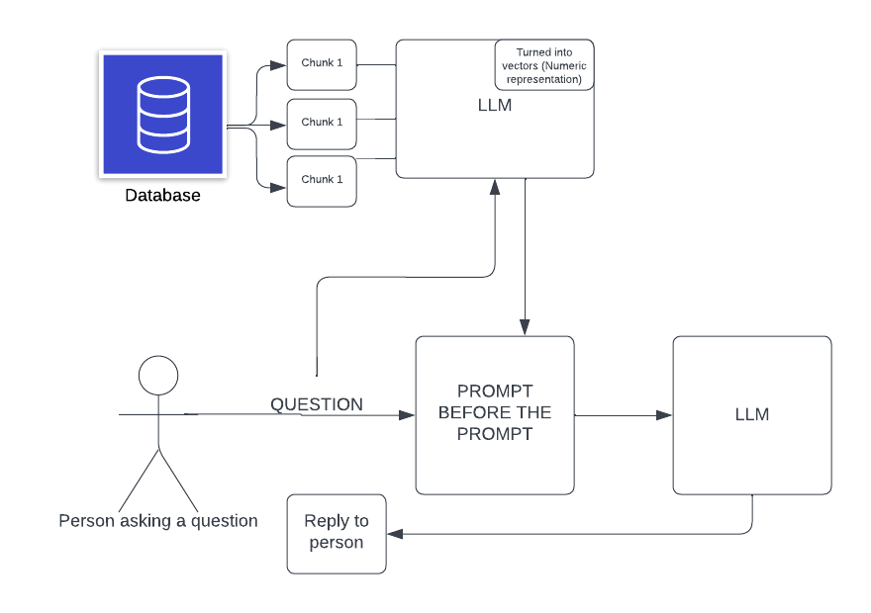
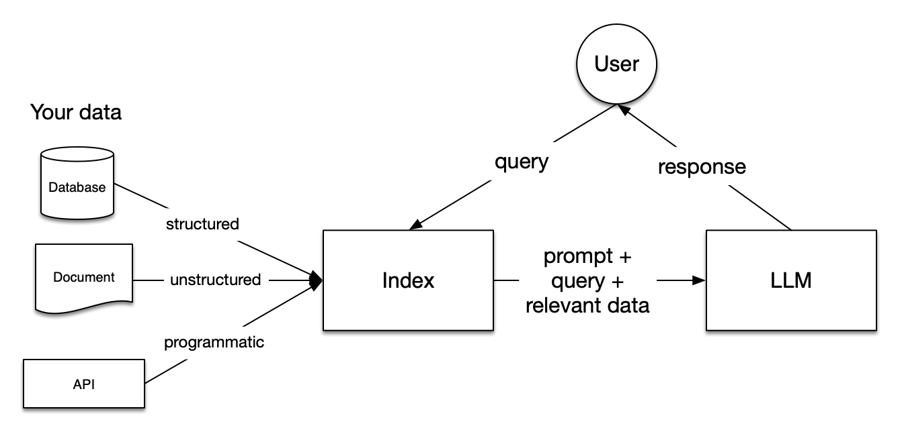
Vendor analysis to maximize value and optimize costs
[Neo4j]
A graph database using Cypher to organize and query nodes and relationships efficiently
Optimizes complex data relationships for contextual and precise information retrieval
Designed for high performance scenes
[Microsoft]
Processes structured and unstructured data into indexed entities and relationships
Retrieves indexed data and enriches user queries with contextual knowledge from the graph
Designed for accuracy and security
[LlamaIndex]
LlamaIndex connects LLMs to external data sources, enabling efficient retrieval of structured and unstructured information
It supports natural language queries, integrates with OpenAI or local models with tailored implementation options
Designed for knowledge extraction
Introduction
Technical Components
Conclusion
Vendor Analysis
Change Management
Financials
Timeline
Risk Mitigation
6

Slide 7
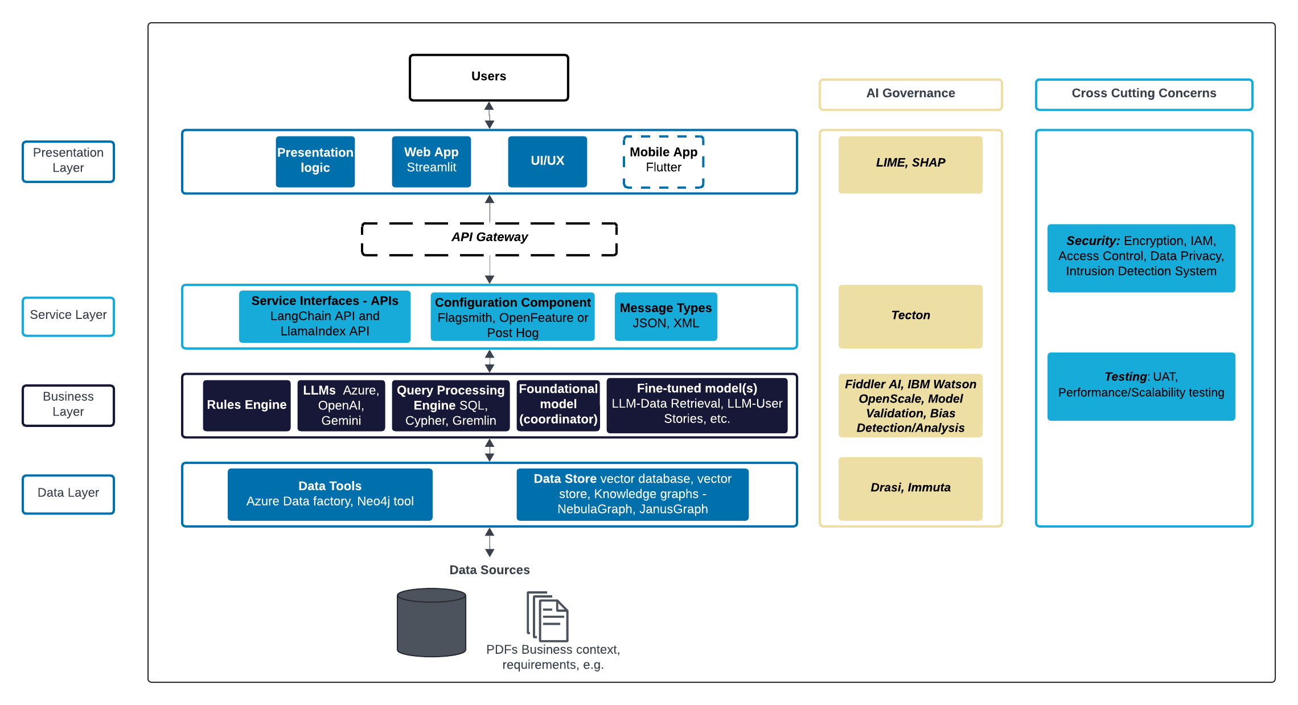
Architecture diagram representing a blueprint for the solution:
Introduction
Technical Components
Conclusion
Vendor Analysis
Change Management
Financials
Timeline
Risk Mitigation
7

Slide 8
The vendor assessment shows how Microsoft is the best choice
Why Microsoft GraphRAG for our use case:
SCALABILITY
Handles large data volumes efficiently for enterprise-scale application
EASE OF INTEGRATION
Integrates seamlessly with Microsoft tools like Azure and Office, making it highly adaptable
Offering | Selection Matrix total
Microsoft GraphRAG | 5.35
Llama Index | 4.36
Neo4j | 4.21
SECURITY COMPLIANCE
Prioritizes data security and compliance, adhering to industry standards for sensitive data
COST TRANSPARENCY
Calculator provided where after adding each component, can see what is the total price per component
USE CASE FIT
Optimized for retrieval-augmented generation (RAG), making it ideal for document retrieval use cases
REAL TIME DATA PROCESSING
Excels in handling both structured and unstructured data, providing versatility
Introduction
Technical Components
Conclusion
Vendor Analysis
Change Management
Financials
Timeline
Risk Mitigation
8

Slide 9

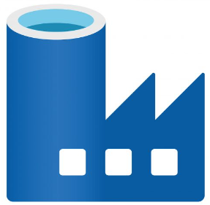


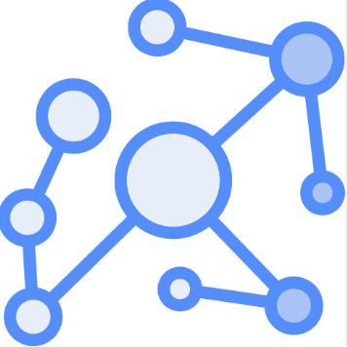

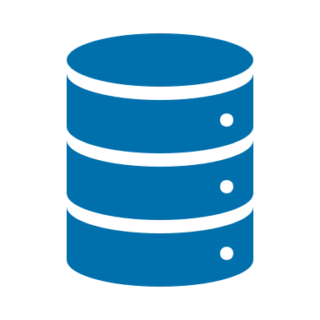
Utilizing Microsoft GraphRAG with Azure
FRONTEND
INTERFACE
BACKEND
AZURE AI SEARCH
Used to query the knowledge graph retrieving relevant data for input into the LLM.
Azure Data Factory: Automates the process of ingesting data from various large-scale sources enabling KG to be continuously updated with fresh, diverse data
Search queries
Employs tools like NebulaGraph for creating and managing the knowledge graph
Input queries
USERS
queries for specific documents or data, new documents or updates
ORCHESTRATOR
Co-ordinate between Azure AI search+ KG
Prompt & knowledge → Response
Additional Data from databases
AZURE OPEN AI
An LLM for generative AI processes the retrieved information to generate responses
Microsoft
Azure GraphRAG
Github - GraphRAG
Introduction
Technical Components
Conclusion
Vendor Analysis
Change Management
Financials
Timeline
Risk Mitigation
9

Slide 10
The timeline implements a pilot first, and then large-scale deployment
 | ’25 Q1 |  |  | ’25 Q2 |  |  | ’25 Q3 |  |  | ’25 Q4
Activity (2025) | Jan | Feb | Mar | Apr | May | Jun | July | Aug | Sept | Oct | Nov | Dec
Preparation and Planning: Finalize system architecture, set up azure ecosystem and databases
GraphRAG Development: Develop the Frontend for user queries, Orchestrator , Azure AI Search and NebulaGraph and test individually
Initiate Change Management: Introduce the concept to teams, prepare stakeholders for step 1 and 2 of Kotter's and ADKAR
Component integration: Integrate all components and perform end to end testing
Deployment: Deploy the system in prod for people to use, perform hot fixes for bugs
Change Management: Encourage employees and others to use the system
Future Roadmap: Scalability, advanced features, cross-platform integration, and continuous innovation
Continuous Improvement
Introduction
Technical Components
Conclusion
Vendor Analysis
Change Management
Financials
Timeline
Risk Mitigation
10

Slide 11
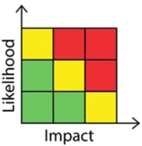
Based on a risk analysis, mitigation strategies have been prepare to ensure success throughout the implementation
Identified Risk
Mitigation Plan
Security and Privacy Concerns: Sensitive data used for generating user stories may be exposed to unauthorized access or misuse
Implement a zero-trust security model that continuously verifies and restricts access to sensitive data based on user roles, device health, and contextual factors
Regularly audit and monitor data usage logs to identify and respond to suspicious activities promptly
High Computational Cost: Using GraphRAG for large-scale user story generation may require significant computational resources, increasing costs upon scalability
Optimize the GraphRAG pipeline for efficiency, such as caching frequently used data and fine-tuning only necessary components
Leverage cloud-based scalable resources in Azure to manage costs dynamically
Project Timeline Delays: Unexpected technical challenges or resource constraints may delay project milestones
Use Agile methodologies to break the project into manageable sprints, allowing for flexibility in addressing challenges
Maintain a buffer in the project timeline to accommodate unforeseen delays
Introduction
Technical Components
Conclusion
Vendor Analysis
Change Management
Financials
Timeline
Risk Mitigation
11

Slide 12







A summary of the solution shows tangible benefits that can be monitored with KPIs
Integration of Knowledge Graphs (KG) with LLM enhances automation, streamlining tasks
Efficiency
Scalability
Cost Optimization
The architecture design supports increased workload and growing organizational needs
The financial model gives a holistic overview of costs and savings
Vendor Assessment
User Satisfaction
Thorough vendor assessment ensures selection of the best-fit solution for long-term project success
Change Management strategies ensure users are on board
Introduction
Technical Components
Conclusion
Vendor Analysis
Change Management
Financials
Timeline
Risk Mitigation
12

Slide 13
THANK YOU!

Slide 14
APPENDIX

Slide 15


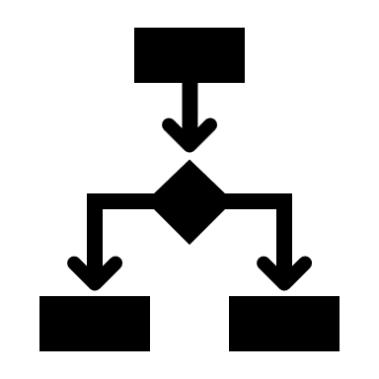

ChatGPT and other revolutionary chatbots are built on Large learning models with the ability to function just like humans
Large Language Models (LLMs) are advanced machine learning models specifically designed to process, understand, and generate human language
Architecture
Training
LLMs use Transformer architecture, which employs special techniques like attention and self-attention to consider each word in the context of the entire sentence
LLMs are trained on large datasets that include text from books, articles, websites, and other written sources, which enables them to learn a wide vocabulary and various language patterns
Capabilities
Challenges
Text generation
Translation
Summarization
Question answering
Sentiment analysis
Bias: LLMs can manifest or amplify biases present in their training data.
Interpretability: The complexity of LLMs makes them difficult to interpret outputs.
Sometimes LLM produce results that maybe outdated or without enough backing of proof
SOLUTION: RAG
Appendix
15

Slide 16
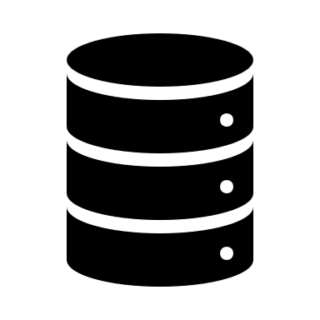


RAG makes AI more effective in providing precise answers
Retriever-Augmented Generation (RAG) is a type of AI technology that improves how it generates text by first gathering relevant information from large data sources and then using that information to create detailed and accurate responses. This process makes the AI more effective in providing precise, curated answers and handling in-depth discussions
Data Retrieval
Data from various sources is segmented into chunks and converted into vectors for easier processing by neural networks, which is then used by the LLMs to find relevant information based on the query
Question Processing
The user’s question is converted into a vector and compared with vectors in the database. The closest matches are combined into a "prompt before the prompt," which may include additional instructions
Response Generation
The system analyzes the prompt and retrieved data to generate a coherent response that is contextually relevant. It then refines the response for clarity and accuracy before delivering it back to the user
1) What is RAG? 2) LLM Intro
Appendix
16

Slide 17
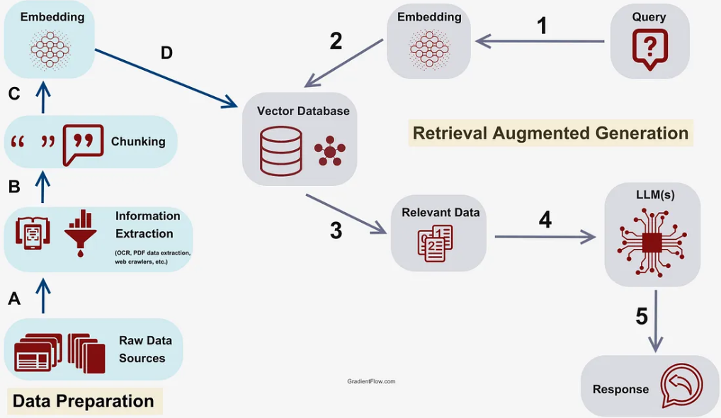
Understanding RAG
This involves using a language model to generate responses based on both the retrieved information and the initial prompt
Retrieval-Augmented Generation (RAG) is a technique that enhances the capabilities of language models, particularly in generating more accurate and contextually relevant text, by incorporating external information retrieval
GENERATION
This involves fetching relevant information from a large corpus or database (such as documents or knowledge bases) based on a query or prompt
RETRIEVAL
Enhanced Contextual Understanding
Improved accuracy
Dynamic, real-time knowledge access
Augmented Language Models
Intro to RAG
Appendix
17

Slide 18
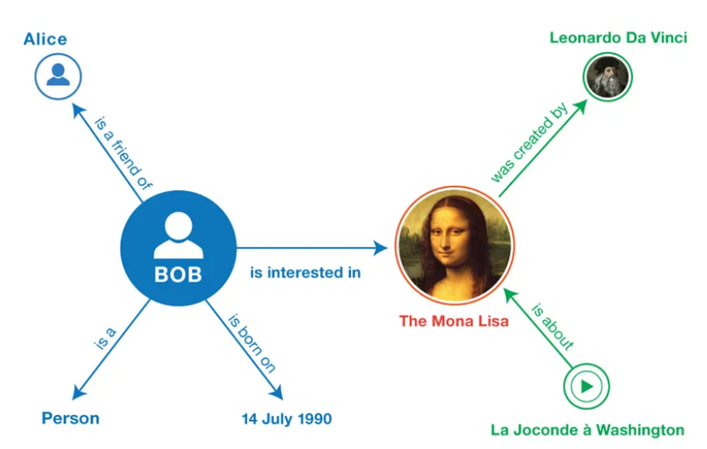
Knowledge Graphs give more context to data storage
KG organize and represent knowledge in a way that captures relationships between entities (nodes) and the connections (edges) between them
Knowledge graphs are a collection of multiple facts comprising of <head, relationship, tail>
Nodes: Real world objects that are represented as nodes
Relation: Connection between entities
This grows organically as more information is added
Entity
Entity
Relationship
Search Engines: Search engines like Google use knowledge graphs to improve search results, helping to understand the relationships between search queries and providing more accurate and contextual results
1
Recommendation systems: Platforms like Amazon, Netflix, and Spotify use knowledge graphs to enhance recommendations by understanding user preferences, product similarities, and customer behavior patterns
2
3
Virtual Assistants: Assistants like Siri, Alexa, and Google Assistant use knowledge graphs to provide more contextually relevant answers by understanding the relationships between entities in a question
Appendix
18

Slide 19
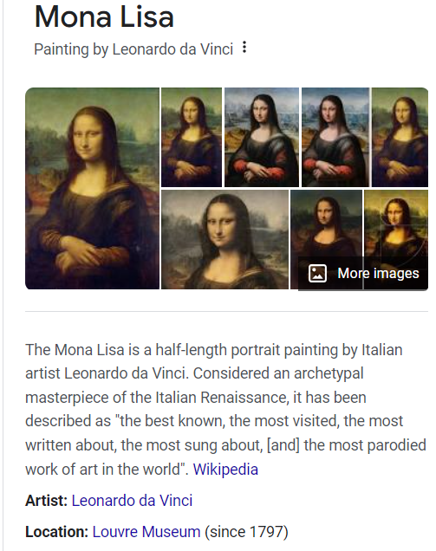
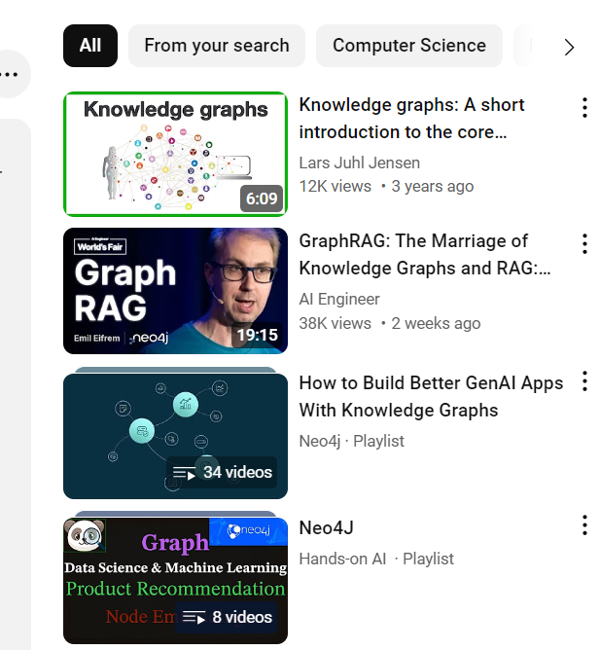
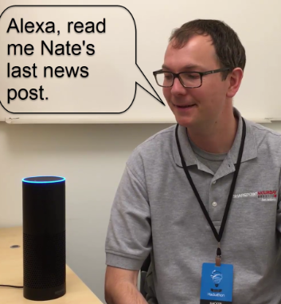
Everyday use cases of Knowledge graphs
When I search Mona Lisa on google, it gives the artist, location and other details by fetching data through KG
When I watch a video on YouTube, it gives me recommendations on the same topic below
When I tell Alexa to give me info, it comprehends knowledge better through knowledge graphs
Appendix
19

Slide 20
Knowledge graph + LLM = GraphRAG
How does it utilize knowledge graphs?
Structured Data Retrieval:
GraphRAG pulls structured information from knowledge graphs along with their interconnections (e.g., partnerships, competitors)
Contextual Insights:
It leverages relationships between entities (clients, markets, services) to offer deeper insights and answer complex questions (e.g., supply chain links with competitors)
Enhanced Decision Support:
By analyzing relationships, GraphRAG delivers consulting-ready outputs, offering a comprehensive view of clients’ business landscapes and market positioning
Efficient Knowledge Utilization:
GraphRAG quickly navigates complex networks, retrieving relevant data to support strategic decision-making and tailored client solutions
What is GraphRAG?
GraphRAG combines the text generation power of an LLM with the structured, relational data from Knowledge Graphs.
It allows for smarter, more context-aware text generation by leveraging real-time retrieval of relationships between entities.
How does it work?
Input:
User provides a question or prompt
Graph Search:
The system retrieves relevant data from the Knowledge Graph
Entity Relationships:
It identifies connections between key entities (nodes) and their relationships (edges)
Text Generation:
LLM combines graph’s structure data with generative capability, giving context rich reply
Appendix
20

Slide 21
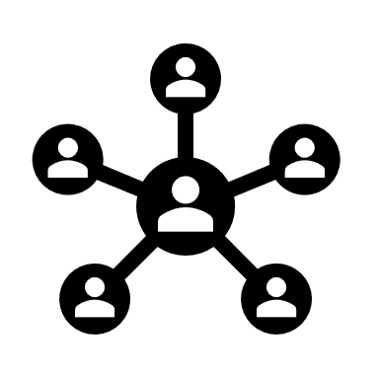

Graph RAG introduces an additional layer of complexity and capability by using a graph-based approach
Key Differences between GraphRAG and RAG
Graph-Based Retrieval
Data Structure
Graph model | Flat text
Instead of treating the knowledge base as a flat collection of text, Graph RAG structures the data in a graph format where nodes represent entities or pieces of information, and edges denote relationships between these entities
Contextual Understanding
Captures relationships | Based on similarity
Generation with Graph Context
Use Cases
Best for complex, relational queries | Best for simple retrievals
The generator uses the graph-structured information to produce responses that are informed not just by the content of individual nodes but also by their relationships in the graph
While both systems aim to augment generation tasks with retrieved knowledge, GraphRAG offers an advanced approach by utilizing the structural relationships inherent in graph data models, potentially leading to richer and more effective generation outcomes
Appendix
21

Slide 22
Leading players’ offerings that can be consider for our project
NebulaGraph
designed for high-performance scenarios, especially when working with massive datasets
highly efficient in handling complex queries in real-time while ensuring low-latency responses
FOR OUR USECASE, MICROSOFT SEEMS LIKE A GOOD CHOICE
Scalability & Throughput
Microsoft's GraphRAG is good at synthesizing information across multiple documents, which is critical for a company’s needs in compiling comprehensive analyses
Microsoft's focus on security and compliance in its GraphRAG implementation means that sensitive data is handled with the requisite care, adhering to industry standards
Designed for enterprise-scale applications, Microsoft's GraphRAG can handle large volumes of data efficiently
If the company uses any existing Microsoft products like office/Azure, integration could be relatively easier, and support can be higher
Neo4j
robust tools for querying complex relationships between entities and excellent support for both real-time querying and batch processing.
highly scalable solution with deep graph analytics capabilities and a strong focus on real-time data processing
Real time data processing
Microsoft
Microsoft Research’s version of GraphRAG focuses heavily on narrative data and private dataset retrieval
Designed to improve accuracy, handle complex multi-document queries, and reduce hallucinations by grounding responses in structured data
private dataset retrieval
Llama Index
LlamaIndex focuses on integrating large-scale unstructured data into structured knowledge graphs, versatile for applications with narrative or semi-structured data
ideal for use cases involving knowledge extraction from documents, research papers, or even healthcare reports
unstructured data sources
A final Decision will be made after evaluating costs incurred for each of these offerings!
Appendix
22

Slide 23
Why Microsoft GraphRAG over the others – Selection matrix
 | Criteria | Weight | Microsoft GraphRAG | Llama Index | Neo4j | Reason for score | Microsoft weighted | Llama index weighted | Neo4j weighted
1 | Scalability | 0.15 | 4 | 4 | 4 | All of the options support scalability | 0.6 | 0.6 | 0.6
2 | Ease of Integration | 0.12 | 5 | 3 | 3 | GraphRAG Integrates seamlessly with Microsoft tools like Azure and Office, making it highly adaptable | 0.6 | 0.36 | 0.36
3 | Security Compliance | 0.2 | 5 | 4 | 3 | Microsoft GraphRAG has the most security and great for sensitive data | 1 | 0.8 | 0.6
4 | Cost transparency | 0.1 | 4 | 2.5 | 3 | Microsoft is the only one that has shared a calculator for values, others need to contact sales team | 0.4 | 0.25 | 0.3
5 | Use case fit – Document retrieval | 0.2 | 5 | 4 | 4 | All 3 optimized for Retrieval Augmented Generation (RAG) | 1 | 0.8 | 0.8
6 | Use case fit- User story generation | 0.2 | 5 | 4 | 4 | Effectively combines LLMs with knowledge graphs to support complex narrative generation | 1 | 0.8 | 0.8
7 | Real time data processing | 0.15 | 5 | 5 | 5 |  | 0.75 | 0.75 | 0.75
Appendix
23

Slide 24
A summary of our solutions
KPI: Reduced time for user story generation and document retrieval by 50%
Integration of Knowledge Graphs (KG) with LLM enhances automation, streamlining tasks
Efficiency
Scalability
Cost Optimization
KPI: System scalability to handle more docs and users
The architecture design supports increased workload and growing organizational needs
KPI: Low, Medium, and High-cost scenarios increasing visibility
The financial model gives a holistic overview of costs and savings
Vendor Assessment
User Satisfaction
KPI: Selection matrix score across RAG, Neo4j, and other vendors
Thorough vendor assessment ensures selection of the best-fit solution for long-term project success
KPI: Expected improvement in user experience measured by NPS
Change Management strategies ensure users are on board
Appendix
24

